Slide 1

Period End Closing Execution (BSC)
Period End Closing Key Process Areas and New Period End Checks
Posting Period Control
Intercompany and Period End Closing
Lease Accounting and Period End Closing
Cost Management Closing Activities
Period End Closing for Accruals and Recurring Entries
Period End Data Checks
Asset Accounting Closing Activities
VAT Clearing and Reporting
GR/IR Closing Activities
Material Ledger Closing (Non-GSC Activities)
Automatic Clearing of LSC¹⁾ Accounts
G/L Closing Activities for Financial Statement Preparation
¹⁾ LSC – Accounts with indicator “Clearing Specific to Ledger Groups” active.

Slide 2
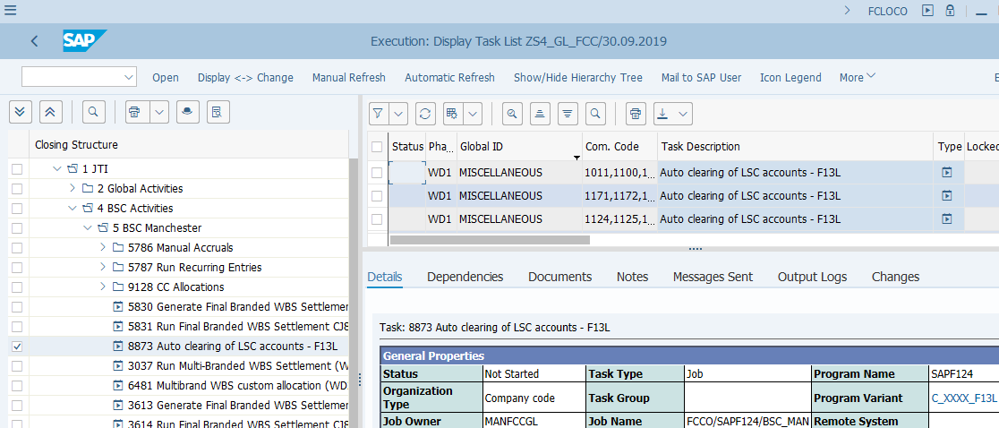
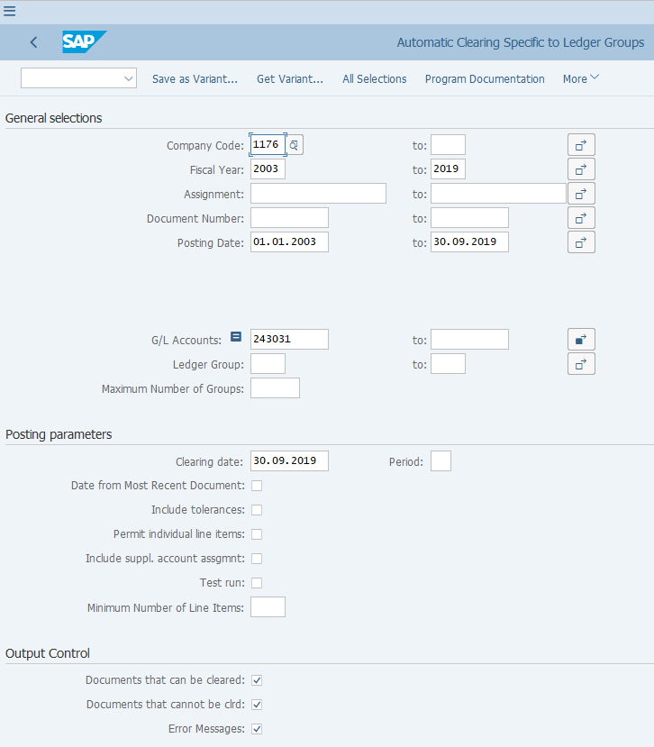
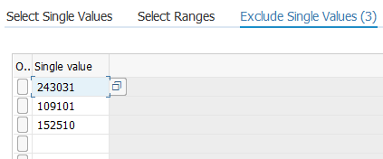
Automatic Clearing of LSC¹⁾ Accounts (1/2)
FCLOCO: FCC Task List
F13L: Automatic Clearing specific to Ledger Groups
Auto Clearing of LSC Accounts:
In S/4 HANA G/L accounts with indicator “Clearing Specific to Ledger Groups” (known as LSC accounts in JTI) are introduced in the Parallel Ledger environment. This means we will have accounts which receive ledger specific postings and can be cleared in specific ledger groups.
F13L is a new transaction in S/4 which allows the LSC accounts to be cleared. The F13L functionality is described in the Parallel Ledger course, which can be run for any LSC accounts as long as the automatic clearing criteria are configured.
F13L is included in FCC and run once per month for all LSC accounts unless specifically excluded (see screenshot) on WD1. This will ensure that only open items are left on these accounts, which provides a clean balance sheet that helps the subsequent closing processes such as Revaluation, Translation, etc., to achieve accurate calculations and postings.
This is a “global variant”. Therefore it is important you review/amend the Company Code field and ensure the Fiscal Year and Posting Period are correct when executing F13L outside of FCC.
¹⁾ LSC – Accounts with indicator “Open Item Mgmt by Ledger Group” active. It was previously “Ledger Specific Clearing”, hence the abbreviation “LSC”

Slide 3
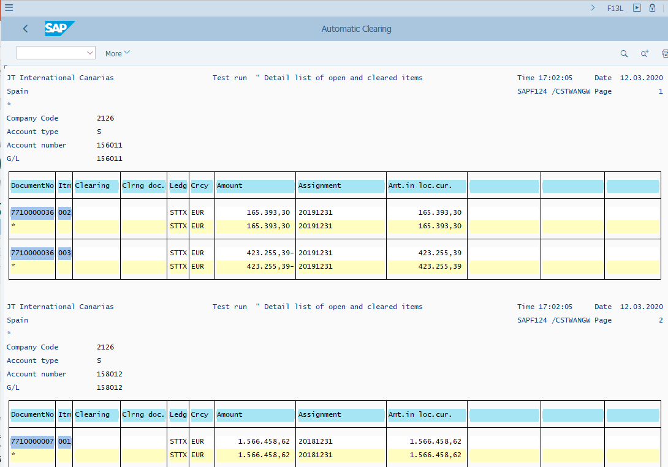
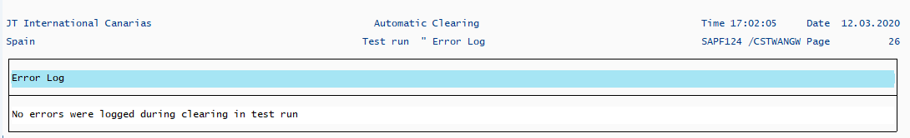
Automatic Clearing of LSC¹⁾ Accounts (2/2)
F13L: Automatic Clearing specific to Ledger Groups Output
Auto Clearing of LSC Accounts – Manual Execution:
If you execute F13L as part of Period End Closing but outside of FCC, make sure you use the same variant as stated in the corresponding FCC task.
The F13L FCC task use a “global variant” therefore you should always review/amend the Company Code and dates/periods/years fields before executing it outside of FCC.
As this is a GBS/JTBC level task, make sure you have included the correct entities (e.g. you should add your entity to the variant if you recently have a new entity) in the variant before executing the transaction.
Make sure you save the output including any error log at the bottom of the output.
Like F.13, any items that can be cleared are highlighted in green in the output with clearing document numbers next to them. You can reset the clearing using these clearing document numbers via FBRA should any items need to be reset.
Refer to Parallel Ledger course materials for F.13, F13L and FBRA.
¹⁾ LSC – Accounts with indicator “Open Item Mgmt by Ledger Group” active. It was previously “Ledger Specific Clearing”, hence the abbreviation “LSC”

Slide 4
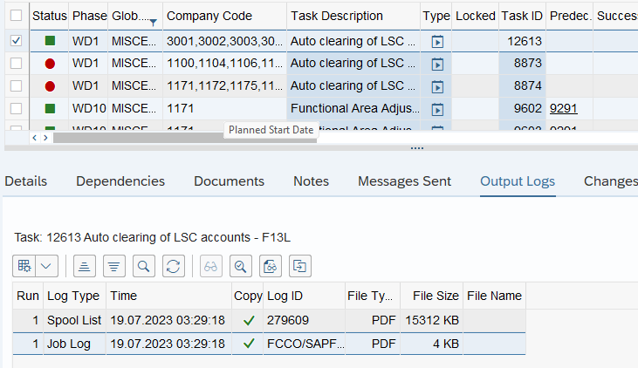
Automatic Clearing of LSC Accounts – Common Errors
If the FCC task returns with an error status, you may check the details of the errors also on the “Output Logs” tab, by displaying the Spool List and Job Log. Usually the Spool List will explain what the errors are.
The below common errors and solutions are not specific for F13L FCC execution, but also when you manually execute F13L.
F13L Transaction Common Errors | Error Reason | Error Resolution
FX clearing accounts are not setup for clearing | FX clearing accounts are not setup in the system for clearing | Contact the Market and ask them to raise the RITM request via the IT Service Portal. Once the request is completed the task can be re-run or executed manually
The difference is too large for clearing | The system confirms that the clearing criteria were not met due to difference in clearing process | No action to be taken, we can ignore the message
No G/L account documents selected | Not a real error, message informing that there is no posting to be cleared for the selected account | No action to be taken, we can ignore the message
No ledger group-specific clearing for the account | Not a real error, message informing that there is no ledger -specific posting to be cleared for the selected account | No action to be taken, we can ignore the message

